Slide 1
IMAGE CLASSIFICATION
Rithik B
KGISL Institute Of Technology
NM ID: au711721243077
3/21/2024 Annual Review

Slide 2


AGENDA
Problem Statement
Project Overview
Who are the end users
Solution and its value proposition
Solution
Modelling
Results
3/21/2024 Annual Review

Slide 3

PROBLEM STATEMENT
Develop multiple Convolutional Neural Network (CNN) models using GPU-enabled Tensorflow and Keras API to accurately classify 32x32 color images from the CIFAR-10 dataset into one of 10 classes. The goal is to achieve high classification accuracy on the test set by exploring different CNN architectures, optimizing hyperparameters, and implementing advanced techniques like data augmentation and transfer learning. The project aims to showcase the effectiveness of deep learning in image classification tasks and provide insights into the performance variations across various CNN models trained on the CIFAR-10 dataset.
3/21/2024 Annual Review

Slide 4

PROJECT OVERVIEW
This project implements and compares different CNN classifiers for the CIFAR-10 dataset using GPU-enabled Tensorflow and Keras API.
The CIFAR-10 dataset contains 60000 32x32 color images in 10 classes, with 6000 images per class.
The project's goals are to implement and compare different CNN architectures for image classification tasks.
The project uses GPU-enabled Tensorflow and Keras API to define and train the CNN classifiers.
The CIFAR-10 dataset is loaded and preprocessed, and different CNN architectures are defined using the Keras API.
The CNN classifiers are trained on the CIFAR-10 dataset using GPU-enabled Tensorflow.
The performance of the CNN classifiers is evaluated on the test set, and the performance of different CNN architectures is compared based on evaluation metrics.
The project helps to understand the performance of different CNN architectures for image classification tasks and how to implement and train them using GPU-enabled Tensorflow and Keras API.
3/21/2024 Annual Review

Slide 5

WHO ARE THE END USERS?
Image classification using the CIFAR-10 dataset is a common task in the field of computer vision, and it can be used by a variety of end users. Here are some examples:
Machine Learning Researchers: Researchers use the CIFAR-10 dataset to develop and test new image classification algorithms and techniques. The small size and well-defined nature of the dataset make it a good choice for prototyping and benchmarking new ideas.
Deep Learning Developers: Developers use CIFAR-10 to learn and practice building convolutional neural networks (CNNs), which are the dominant architecture for image classification tasks. By training a model on CIFAR-10, developers gain experience with the process of building, training, and evaluating CNNs.
Students: The CIFAR-10 dataset is a popular choice for educational purposes due to its simplicity and availability. Students in machine learning or deep learning courses can use CIFAR-10 to gain hands-on experience with image classification concepts.
Hobbyists: Hobbyists interested in computer vision can use CIFAR-10 to experiment with image classification techniques. The dataset is a good starting point for personal projects because of the freely available tools and well-documented examples.
3/21/2024 Annual Review

Slide 6

YOUR SOLUTION AND ITS VALUE PROPOSITION
The "Image-Classification-using-CIFAR-10-dataset" project proposes a solution to build and train image classification models using deep learning techniques.
The solution implements different CNN architectures using GPU-enabled Tensorflow and Keras API for the CIFAR-10 dataset.
The project compares the performance of different CNN architectures to identify the most effective techniques for image classification tasks.
The solution provides a valuable resource for researchers, developers, and students studying image classification and deep learning.
The project's code and techniques can be used as a starting point for further research and experimentation.
The project's value proposition is to advance the state of the art in image classification and provide a valuable resource for the community.
The project's success is measured by the performance of the CNN architectures and the impact on the field of image classification.
3/21/2024 Annual Review

Slide 7

THE WOW IN YOUR SOLUTION
The "WOW" in the solution for "Image-Classification-using-CIFAR-10-dataset" is the implementation of different Convolutional Neural Network (CNN) classifiers using GPU-enabled Tensorflow and Keras API for the CIFAR-10 dataset.
The project's value proposition is to provide a practical example of how to build and train image classification models using deep learning techniques.
By implementing different CNN architectures and comparing their performance, the project can help researchers and developers to identify the most effective techniques for image classification tasks.
The project's code and techniques can be used as a starting point for further research and experimentation, allowing users to build on the work done in the project and apply it to their own image classification tasks.
The project's success is measured by the performance of the CNN architectures and the impact on the field of image classification.
3/21/2024 Annual Review

Slide 8
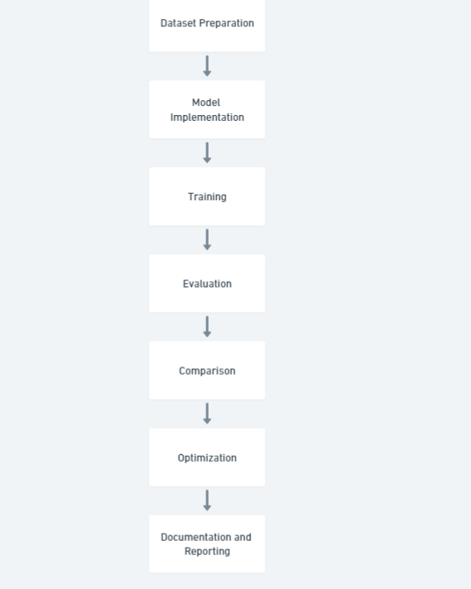
MODELLING
3/21/2024 Annual Review

Slide 9
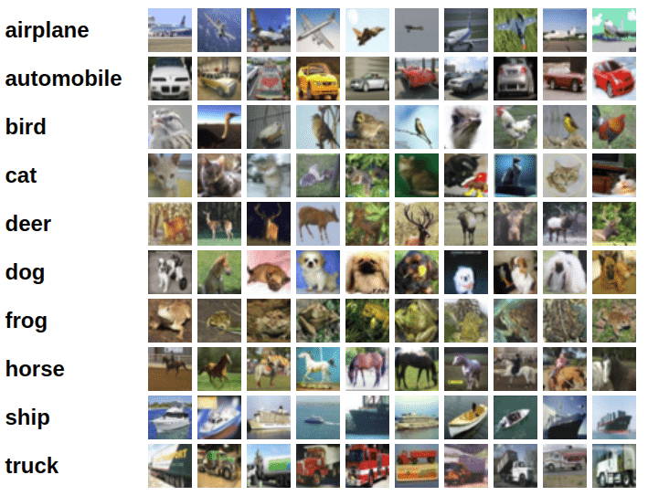
RESULTS
3/21/2024 Annual Review

